Slide 1


Government College of Engineering, Amravati?
(An Autonomous Institute of Government of Maharashtra)
Computer Science & Engineering Department
Minor Project
"OptiPath"
The Path Finding Visualizer

Slide 2
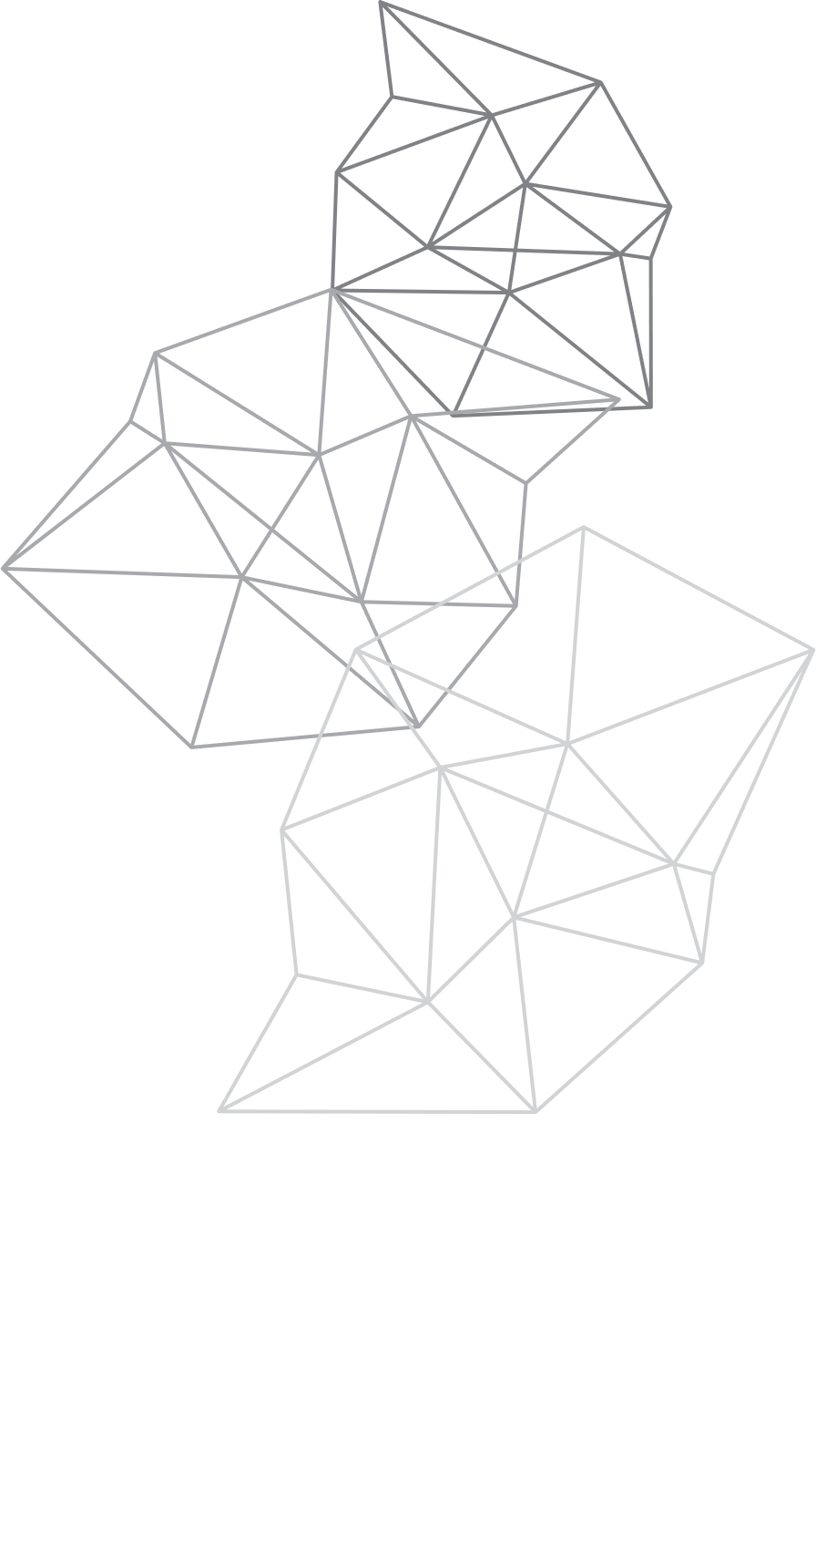
"OptiPath"
The Path Finding Visualizer
PRESENTED BY :
GUIDED BY :
Sakshi Bele (20005039)
Mrunal Deshmukh (20005040)
Shifanaaz Sheikh (20005041)
Aishwarya Dhanvijay (20005055)
Prof. Dr. P.N. Chatur
Prof. Dr. K.A. Waghmare

Slide 3

INTRODUCTION:
Path Finder Visualizer project aims to bridge this knowledge gap and make path-finding algorithms accessible to everyone. Through an intuitive and interactive interface, users can explore and experiment with different path-finding techniques, gaining a deeper understanding of their inner workings.

Slide 4

AIM :
To develop a pathfinding visualizer project that demonstrates various pathfinding algorithms in action.
To provide a visual representation of how different algorithms explore and evaluate paths in a grid or graph.
To enhance understanding and intuition about pathfinding algorithms through interactive visualization.
To create a user-friendly interface that allows users to interact with the visualizer and customize the grid and algorithm parameters.

Slide 5

OBJECTIVE :
Implement a grid or graph representation for the pathfinding algorithms to operate on.
Implement popular pathfinding algorithms, such as Dijkstra's algorithm, A* algorithm, and Breadth-First Search (BFS),Depth First Search(DFS).
Visualize the step-by-step process of each algorithm by highlighting the cells or nodes being explored, visited, and part of the final path.
Allow user interaction to set the start and end points, add obstacles or walls, and trigger the execution of the pathfinding algorithms.

Slide 6

TECHNOLOGIES IMPLEMENTED :
HTML
CSS
JAVASCRIPT

Slide 7

HTML :
HTML is a fundamental language for creating the structure and content of web pages.
It provides a set of tags or elements that define the structure, layout, and presentation of the content on a web page.
In our pathfinding visualizer project, HTML is used to create the user interface and define the elements that make up the visualizer.

Slide 8

CSS :
CSS is a styling language used to control the presentation and appearance of web pages written in HTML.
It provides a set of rules and properties that define how the HTML elements should be displayed on the screen.
In our pathfinding visualizer project, CSS is used to enhance the visual design and layout of the elements in your user interface.

Slide 9

JAVASCRIPT:
JavaScript is a versatile programming language that adds interactivity and dynamic behavior to web pages.
It allows you to manipulate the content and behavior of HTML elements, respond to user actions, and perform calculations or complex logic.
In our pathfinding visualizer project, JavaScript is used to handle user interactions, update the grid, trigger algorithm execution, and manipulate the visual elements dynamically.

Slide 10
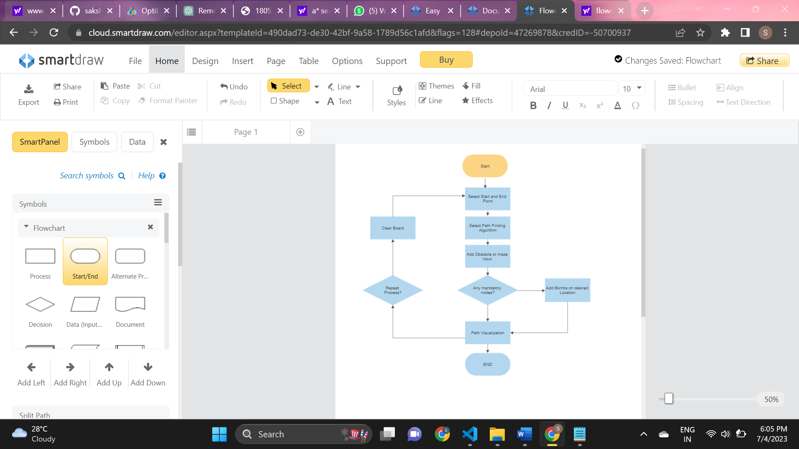
USER MANUAL FLOWCHART FOR "OPTIPATH" :

Slide 11

ALGORITHMS IMPLEMENTED:
Dijkstra's algorithm
A* algorithm
Breadth-First Search (BFS)
Depth-First Search (DFS)

Slide 12
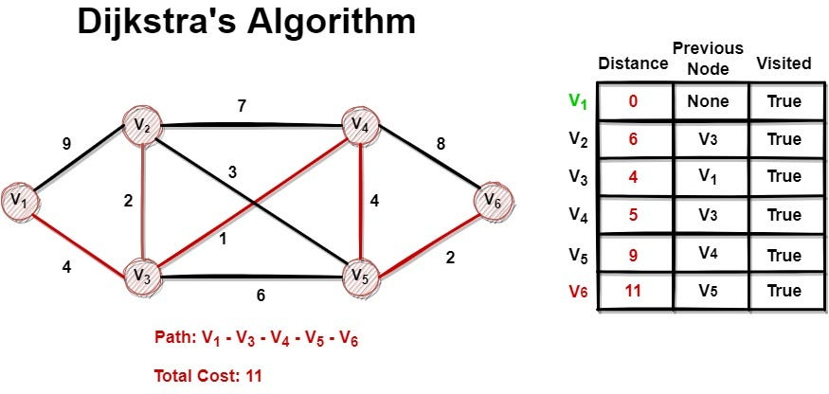
DIJKSTRA'S ALGORITHM :
Dijkstra's algorithm allows us to find the shortest path between any two vertices of a graph.
It differs from the minimum spanning tree because the shortest distance between two vertices might not include all the vertices of the graph.

Slide 13
How Dijkstra's Algorithm works :
Dijkstra's Algorithm works on the basis that any subpath B -> D of the shortest path A -> D between vertices A and D is also the shortest path between vertices B and D.
Shortest subpath property is used by dijkstra's algorithm.
Each subpath is the shortest path
Djikstra used this property in the opposite direction i.e we overestimate the distance of each vertex from the starting vertex. Then we visit each node and its neighbors to find the shortest subpath to those neighbors.
The algorithm uses a greedy approach in the sense that we find the next best solution hoping that the end result is the best solution for the whole problem.

Slide 14
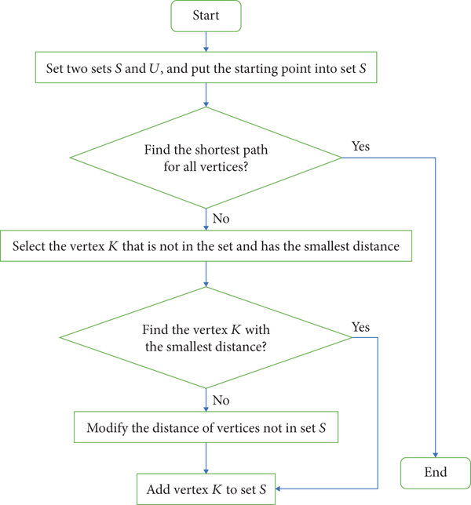
FLOWCHART:

Slide 15
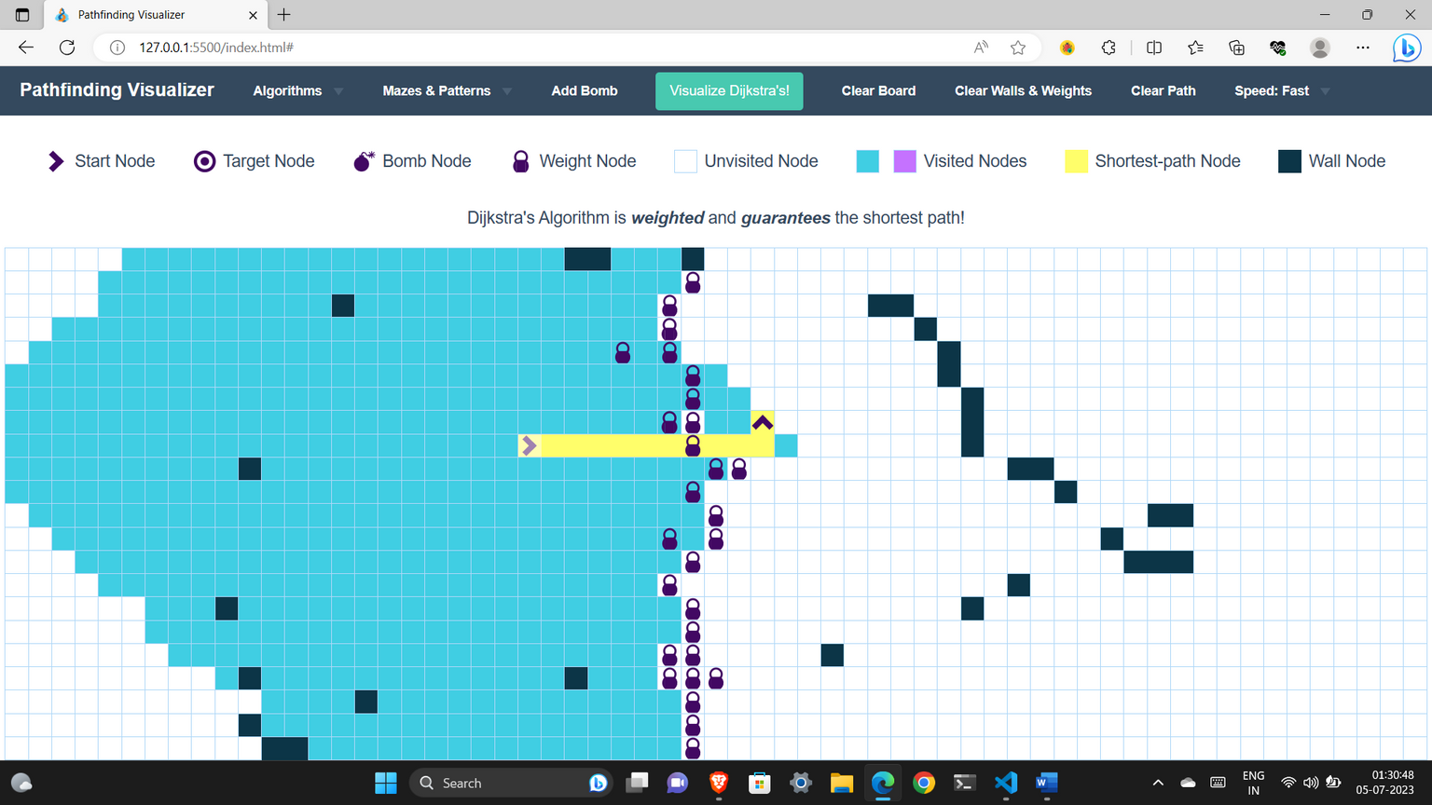
PATH FINDING VISUALIZATION FOR DIJKSTRA'S ALGORITHM :
Path finding visualizer gives the path for Dijkstra's algorithm which is optimal and shortest by considering all the obstacles of walls and weights.
Dijkstra's algorithm is weighted and guarantees the shortest path.

Slide 16
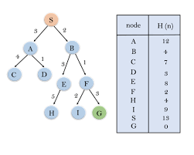
2. A* ALGORITHM :
A * algorithm is a searching algorithm that searches for the shortest path between the initial and the final state. It is used in various applications, such as maps.
In maps the A* algorithm is used to calculate the shortest distance between the source (initial state) and the destination (final state).

Slide 17
How A* Algorithm works :
A* algorithm has 3 parameters:
g : the cost of moving from the initial cell to the current cell. Basically, it is the sum of all the cells that have been visited since leaving the first cell.
h : also known as the heuristic value, it is the estimated cost of moving from the current cell to the final cell. The actual cost cannot be calculated until the final cell is reached. Hence, h is the estimated cost. We must make sure that there is never an over estimation of the cost.
f : it is the sum of g and h. So, f = g + h

Slide 18
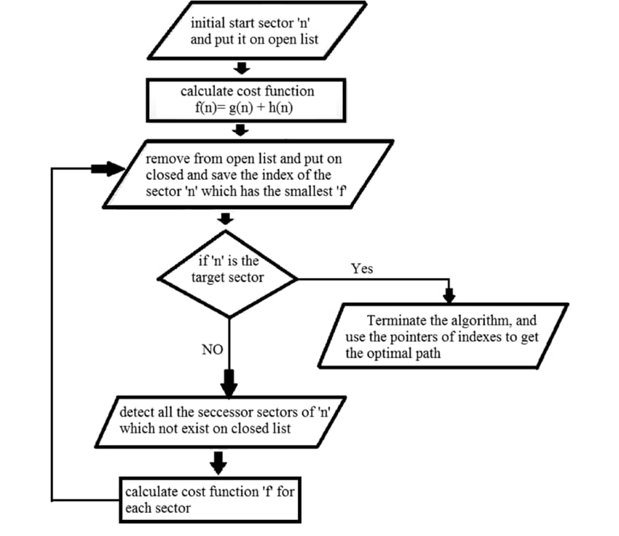
A* FLOWCHART:

Slide 19
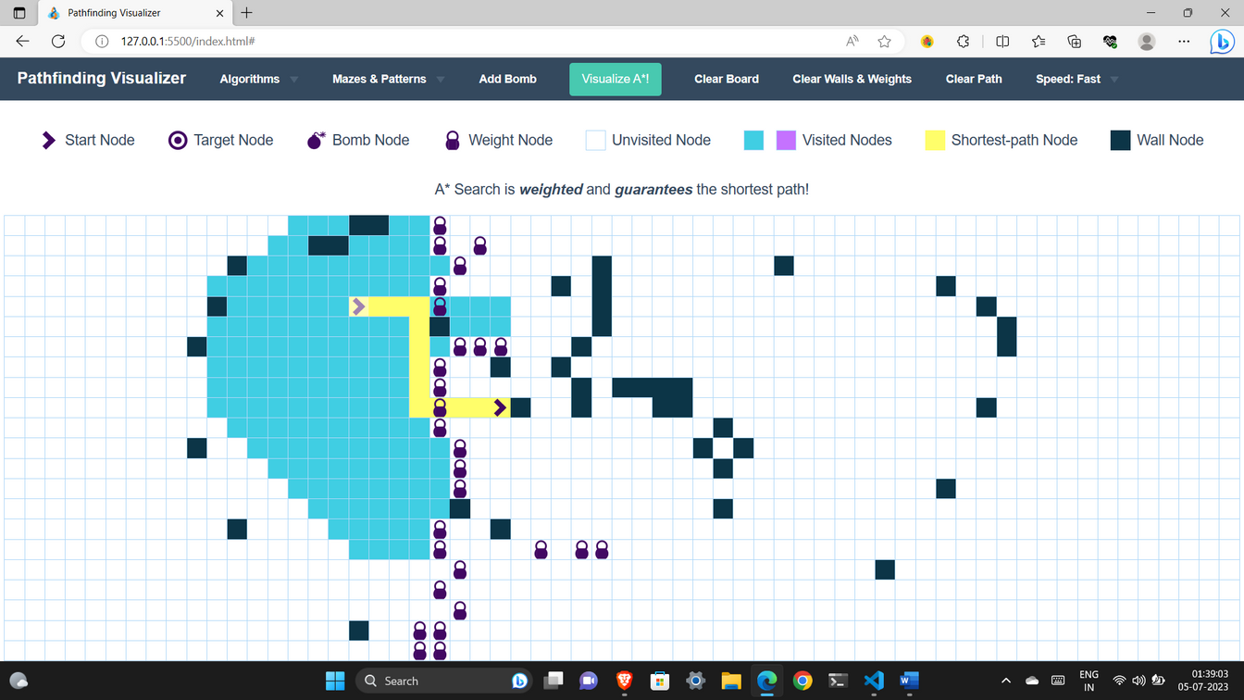
PATH FINDING VISUALIZATION FOR A* ALGORITHM :
Path finding visualizer gives the path for A* algorithm which shortest by considering all the obstacles of walls and weights.
A* algorithm is weighted and guarantees the shortest path.

Slide 20
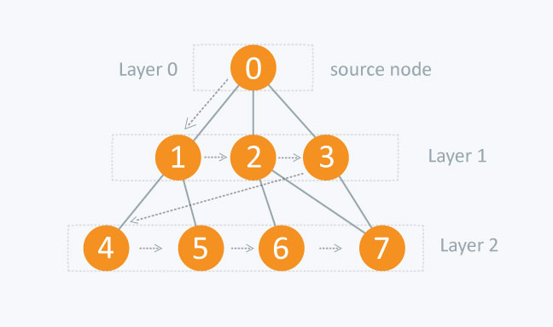
3. BREADTH-FIRST SEARCH ALGORITHM :
Breadth-first search (BFS) is an algorithm used for traversing or searching tree or graph data structures.
It starts at a specified node and explores all its neighbors before moving on to the next level of neighbors.
BFS operates by exploring all nodes at the current depth level before moving to nodes at the next depth level.

Slide 21
How BFS works :
Here's a step-by-step description of the breadth-first search algorithm:
Initialize an empty queue and a set or array to keep track of visited nodes.
Enqueue the starting node into the queue and mark it as visited.
While the queue is not empty, do the following:
Dequeue a node from the front of the queue.
Process the node (e.g., print its value or perform any other desired operations).
Enqueue all unvisited neighbors of the dequeued node and mark them as visited.
Repeat step 3 until the queue is empty.

Slide 22
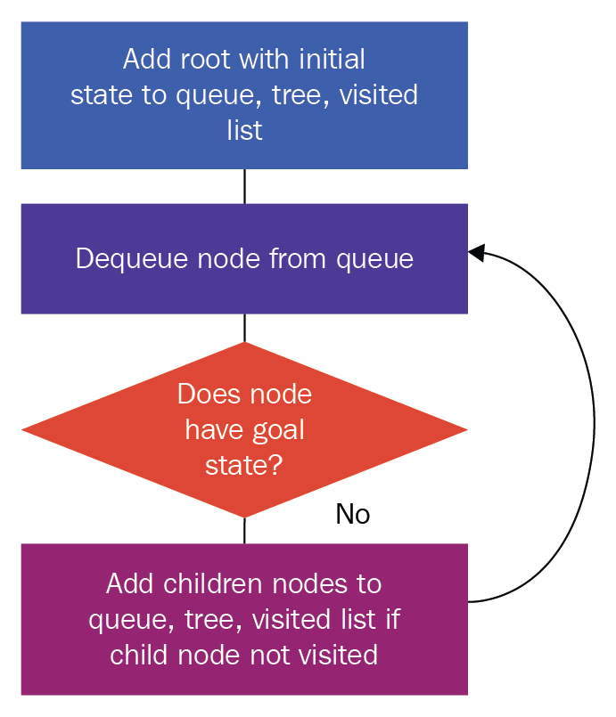
BFS FLOWCHART:

Slide 23
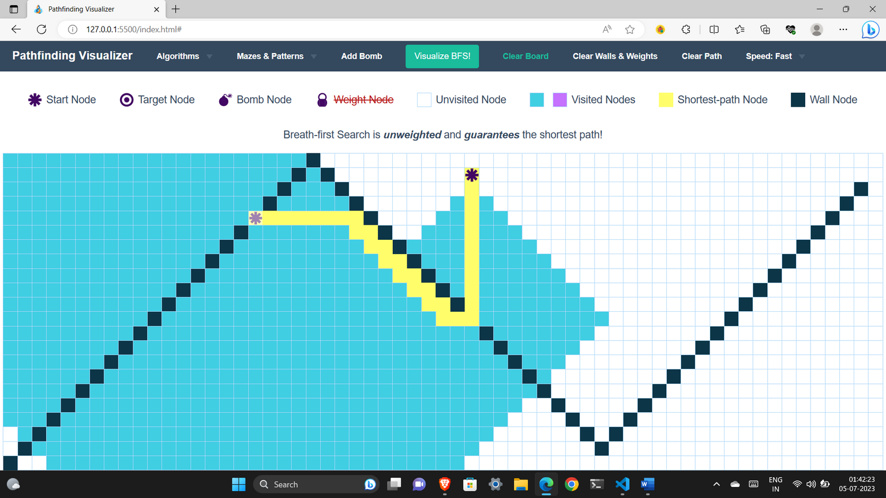
PATH FINDING VISUALIZATION FOR BFS ALGORITHM :
Path finding visualizer gives the path for BFS algorithm which shortest by considering all the obstacles of walls.
BFS algorithm is unweighted and guarantees the shortest path.

Slide 24
4. DEPTH-FIRST SEARCH ALGORITHM :
Depth-first search (DFS) is another algorithm used for traversing or searching tree or graph data structures.
Unlike BFS, DFS explores as far as possible along each branch before backtracking.
It starts at a specified node and visits all of its descendants before moving on to the next sibling node.

Slide 25
How DFS works :
Here's a step-by-step description of the depth-first search algorithm:
Initialize a set or array to keep track of visited nodes.
Start at a specified node and mark it as visited.
Process the node (e.g., print its value or perform any other desired operations).
For each unvisited neighbor of the current node, recursively apply steps 3 and 4 (i.e., move to the neighbor and repeat the process).
Repeat steps 3 and 4 until all reachable nodes are visited.

Slide 26
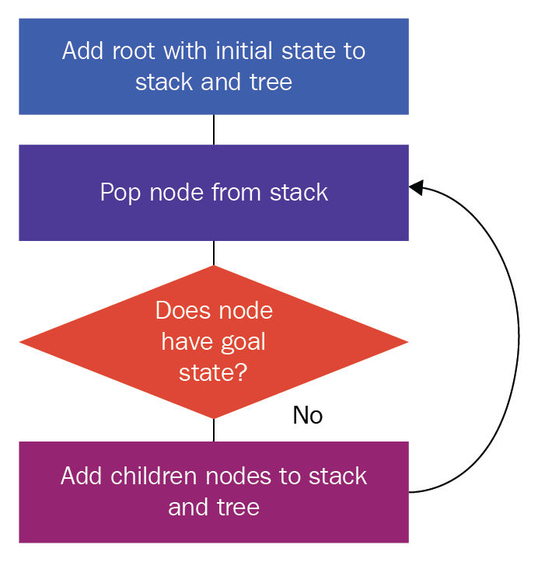
DFS FLOWCHART:

Slide 27
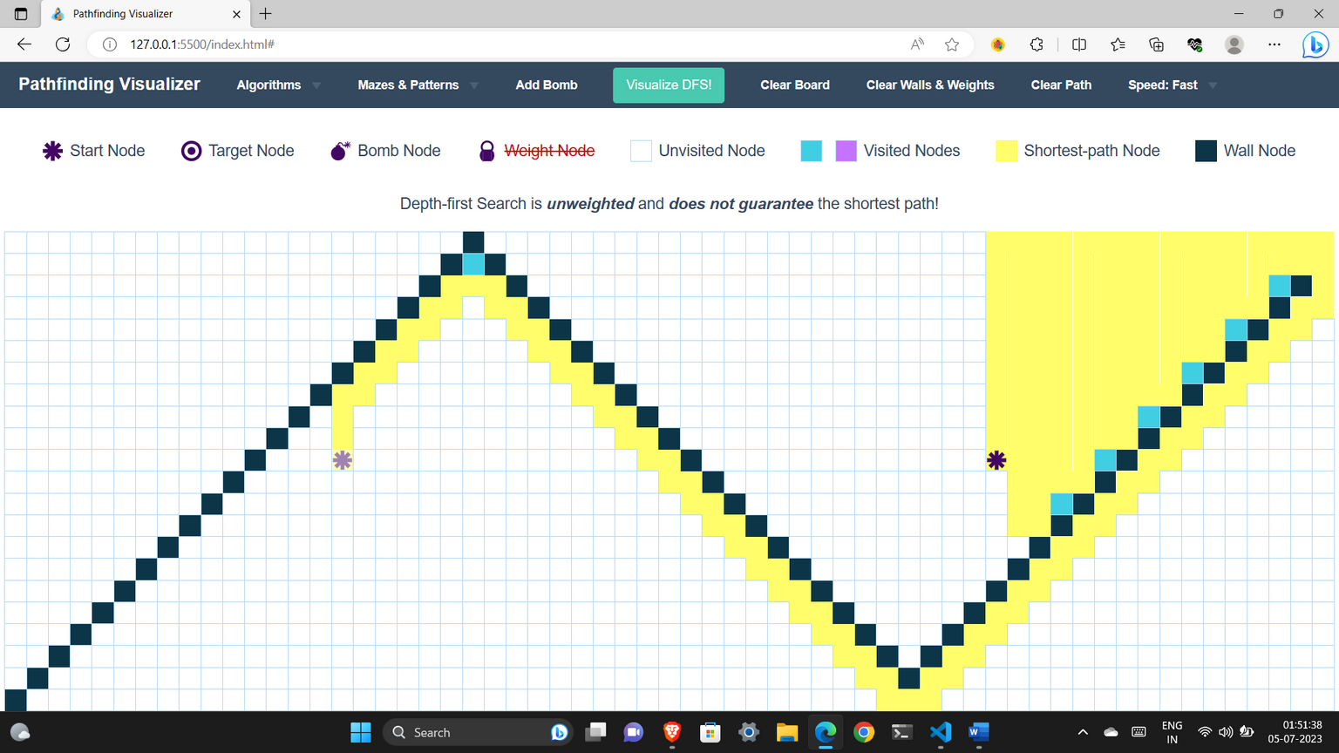
PATH FINDING VISUALIZATION FOR DFS ALGORITHM :
Path finding visualizer gives the path for DFS algorithm which is may or may not be shortest .
DFS algorithm is unweighted and does not guarantees the shortest path.

Slide 28
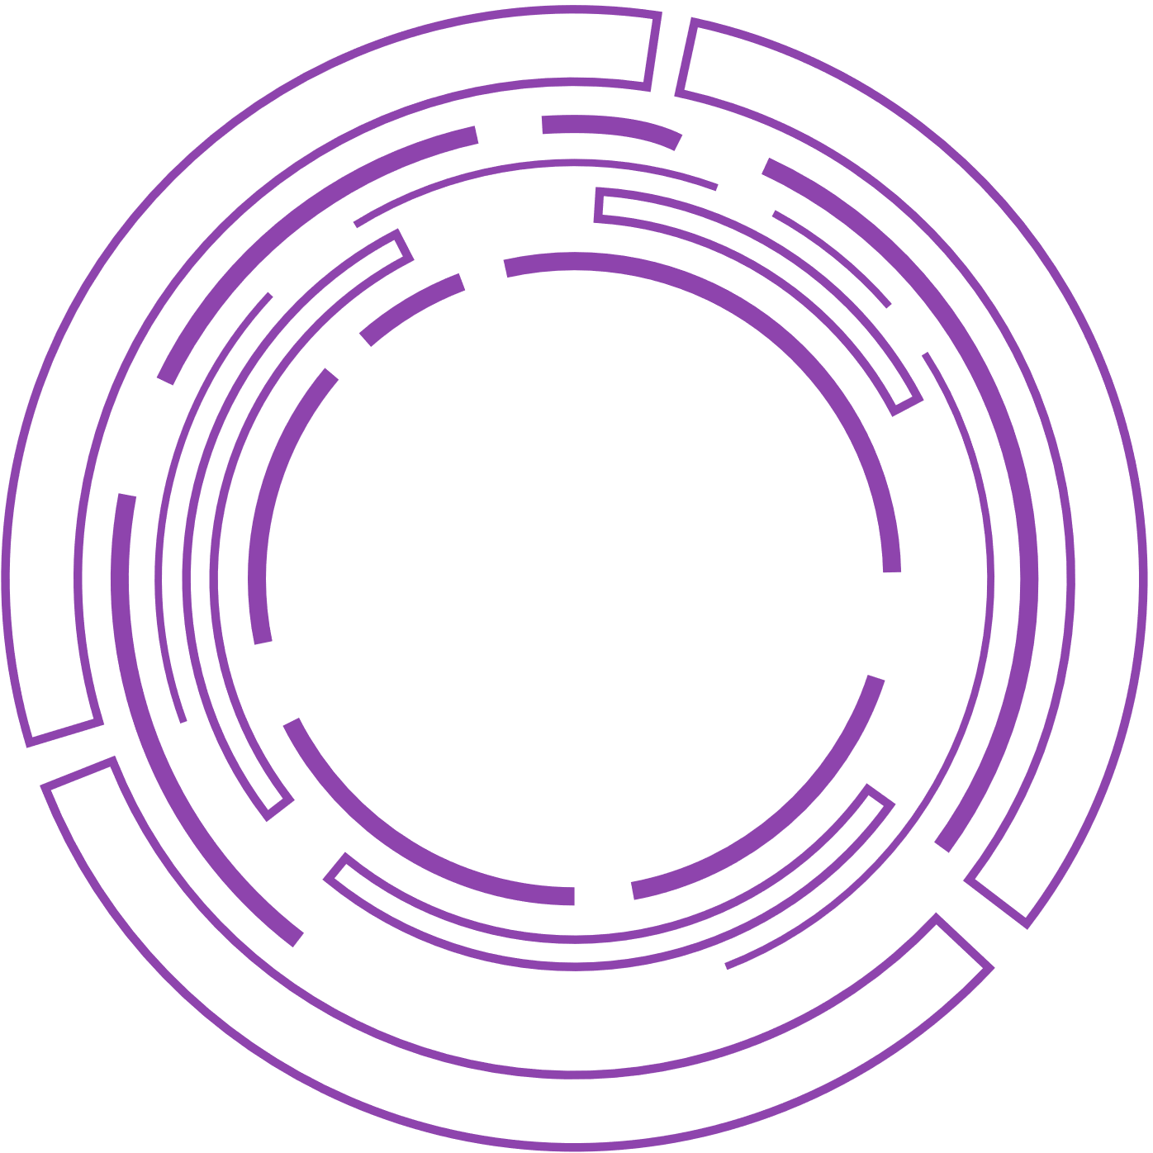
CONCLUSION :
Our Path Finder Visualizer project offers a powerful and interactive tool for understanding and exploring path-finding algorithms. Throughout this presentation, we have highlighted the aim & objectives , technologies used, working of algorithms and the numerous benefits it provides to various users.
By developing this visualizer, we aimed to bridge the gap between theory and practice, allowing users to witness the inner workings of path-finding algorithms firsthand.

Slide 29

REFERENCES :
https://www.geeksforgeeks.org/dijkstras-shortest-path-algorithm-greedy-algo-7/
https://www.geeksforgeeks.org/a-search-algorithm/
https://www.geeksforgeeks.org/breadth-first-search-or-bfs-for-a-graph/
https://www.geeksforgeeks.org/breadth-first-search-or-bfs-for-a-graph/

Slide 30


